Slide 1
Interrupts

Slide 2
Program and Processes
main()
{
…..
foo( )
{
…….
}
bar( )
{
……
}
}
main()
{
…..
foo( )
{
…….
}
bar( )
{
……
}
heap
stack
Register PC
Program
Vs
Process
UFCFWK-15-2 (UWE)

Slide 3
Process
KERNEL
Hardware

Slide 4
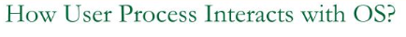
Process
System calls
KERNEL
Hardware
Process is a program in execution.
Process is an active entity, while a program is a passive entity.
This means that a program can be considered as a bunch of code, or sequence of instructions, whereas a process is any such program that is currently active.

Slide 5

Process to a Program
Program is just part of process state
Example: many users can run the same program
Even though the program has a single set of variable names, the same variable in different instances may have different values
The different processes running the program have different address spaces
A program can invoke more than one process Example: Fork off processes
UFCFWK-15-2 (UWE)

Slide 6
Program and Process
Processes are programmed with a built-in notion of timing,
e.g. they share resources with other processes
Processes contain state, generally, not visible to the program,
e.g. SP, PC, and other resources
UFCFWK-15-2 (UWE)

Slide 7
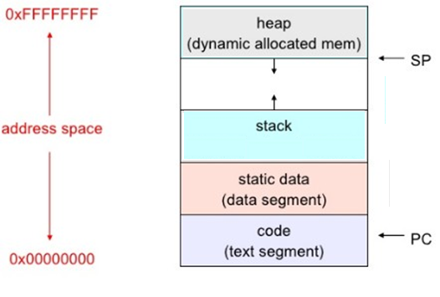
Processes Address Space
Creating Processes
Operating Systems need a way to create processes Operating Systems need a way to terminate processes
UFCFWK-15-2 (UWE)

Slide 8
Creating Processes
Parent process create children processes, which, in turn create other processes, forming a tree of processes
Resource sharing
Parent and children share all resources Children share subset of parent’s resources Parent and child share no resources
Execution
Parent and children execute concurrently Paraent waits until children terminate
UFCFWK-15-2 (UWE)

Slide 9
Creating Processes
Address space
Child duplicate of parent
Child has a program loaded into it
Unix examples
fork system call creates new process
exec system call used after a fork to replace the process’ memory space with a new program
UFCFWK-15-2 (UWE)

Slide 10
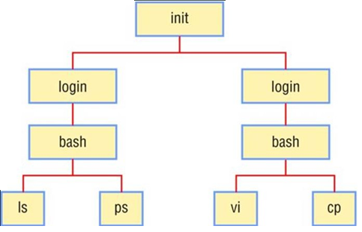
Processes tree
Four Principles Events for Process Creation
System initialisation
Execution of a process-creation system call by a running process A user request to create a new process
Initiation of a batch job
UFCFWK-15-2 (UWE)

Slide 11
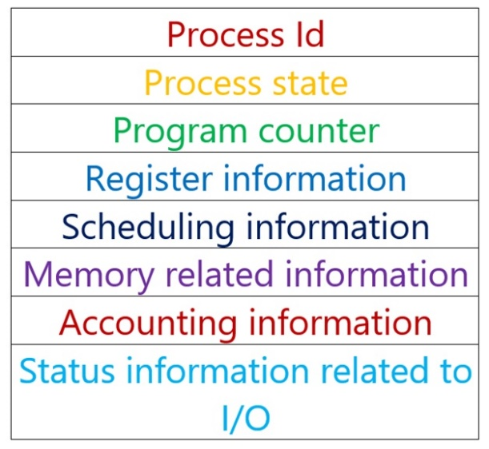
Process Control Block

Slide 12
Process Control Block (PCB)
Each process is represented in the OS by a PCB, information associated with each process
Process state (ready, running, waiting, etc.)
Process counter (indicate the address of the next instructions) CPU registers (accumulators, index register, stack pointer) CPU scheduling information (process priority)
Memory-management information (Base and limit register) Accounting information (amount of CPU time used, time limit, etc.) I/O status information (I/O devices allocated to this process)
UFCFWK-15-2 (UWE)

Slide 13
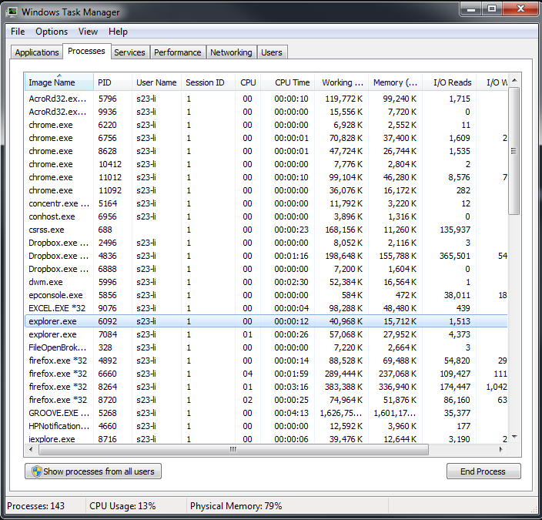
PID
UFCFWK-15-2 (UWE)

Slide 14
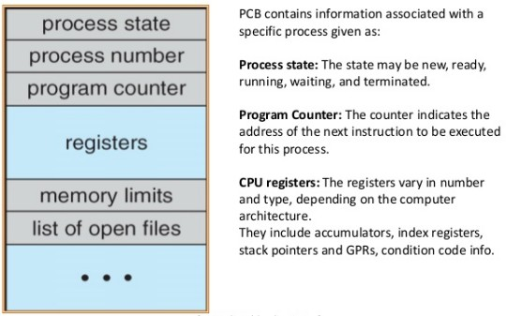
Process Control Block (PCB)
Process management information State
Registers, EFLAGS, and other CPU state Stack, code and data segment
Parents, etc.
EFLAGS is the status register
UFCFWK-15-2 (UWE)

Slide 15
Process Control Block (PCB)
Memory management info
Segments, page table, stats, etc.
I/O and file management
Communication ports, directories, file descriptors, etc.
How OS takes care of processes
Resource allocation and process state transition
UFCFWK-15-2 (UWE)

Slide 16
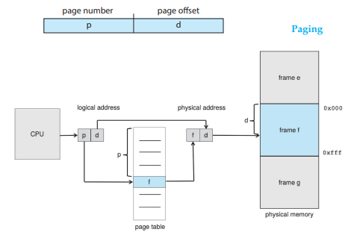
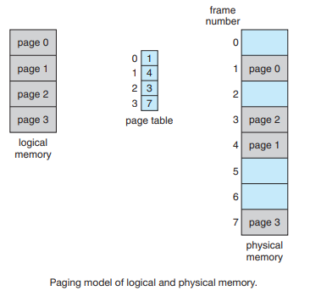

Slide 17

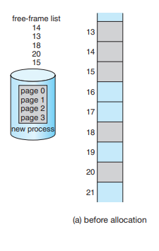
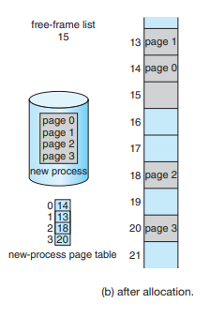

Slide 18
Primitives of Processes
Creation and termination
Exec, Fork, Wait, Kill

Slide 19
Process Termination
Process termination occurs when the process is terminated The exit() system call is used by most operating systems for process termination.
Some of the causes of process termination are as follows −
A process may be terminated after its execution is naturally completed. This process leaves the processor and releases all its resources.
A child process may be terminated if its parent process requests for its termination.
A process can be terminated if it tries to use a resource that it is not allowed to. For example - A process can be terminated for trying to write into a read only file.
If an I/O failure occurs for a process, it can be terminated. For example - If a process requires the printer and it is not working, then the process will be terminated.
In most cases, if a parent process is terminated then its child processes are also terminated. This is done because the child process cannot exist without the parent process.
If a process requires more memory than is currently available in the system, then it is terminated because of memory scarcity.

Slide 20
How Processes are Made
Creation
Load code and data into memory Create an empty call stack
Initialize state to same as after a process switch Make the process ready to run
Clone
Stop current process and save state
Make copy of current code, data, stack and OS state Make the process ready to run
UFCFWK-15-2 (UWE)

Slide 21
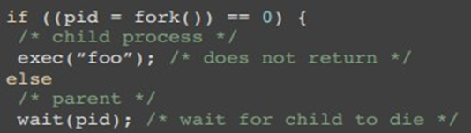
Example: Linux
How to make processes fork clones a process exec overlays the current process
UFCFWK-15-2 (UWE)

Slide 22
Context Switch
Save a context (everything that a process may damage)
All registers (general purpose and floating point) Save all memory to disk?
What about cache and TLB stuff?
Start a context
Does the reverse!
Challenge
OS code must save state without changing any state How to run without touching any registers?
UFCFWK-15-2 (UWE)

Slide 23
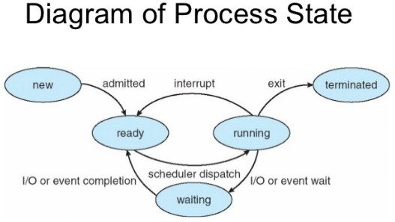
Process State Transition
UFCFWK-15-2 (UWE)

Slide 24
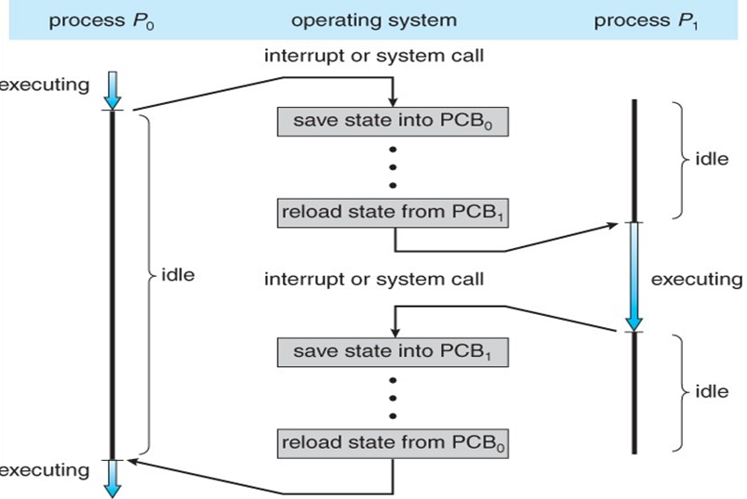
CPU switch from process to process
UFCFWK-15-2 (UWE)

Slide 25
Process scheduling
Process scheduling Queues:
A process resides in different queues during its life cycle
Job queue - set of all processes in the system
Ready queue - set of all processes residing in main memory, ready and waiting to execute
Device queue - set of processes waiting for an I/O device
process migration between the various queues
UFCFWK-15-2 (UWE)

Slide 26
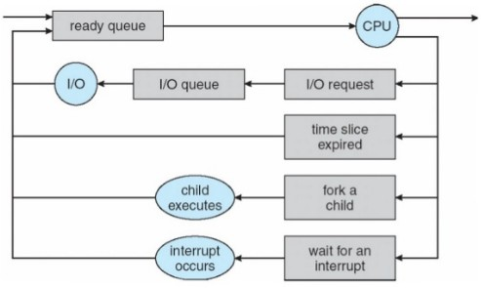
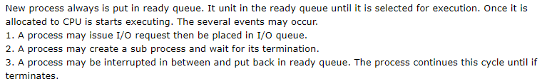
Representation of process scheduling
UFCFWK-15-2 (UWE)

Slide 27
Process Termination
Process executes last statement and asks the OS to delete it (exit)
Output data from child to parent (via wait) Process’ resources are deallocated by OS
Parent may terminate execution of children process (abort)
Child has exceeded allocated resource
Task assigned to child is no longer required If parent is exiting
Some OS do not allow child to continue if its parent terminates - all children terminated
UFCFWK-15-2 (UWE)

Slide 28
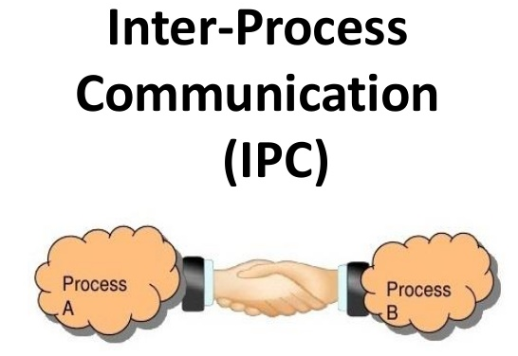
Sharing Memory
Message Passing

Slide 29
Interprocess Communication (IPC)
Mechanism for processes to communicate and to synchronize their actions
Message system - processes communicate with each other without using shared variables and using different address space
IPC facility provides two operations send(message - message size fixed or variable receive(message)
if P and Q wish to communicate, they need to: establish a communication link between them exchange messages via send/receive
Implementation of communication link Physical (e.g., shared memory, hardware bus)
Logic (e.g., logical properties)
UFCFWK-15-2 (UWE)

Slide 30
Thanks!
UFCFWK-15-2 (UWE)

